Slide 1

Algorithms and Data Structures 2 CS 1501
Fall 2021
Sherif Khattab
ksm73@pitt.edu
(Slides are adapted from Dr. Ramirez’s and Dr. Farnan’s CS1501 slides.)

Slide 2
Announcements
Upcoming deadlines:
9/24: Homework 3
10/1: Assignment 1
Traversals of general trees:
Level-order, pre-order, and post-order

Slide 3
Last lecture …
BinaryNode
BinaryTree

Slide 4
This Lecture
BinaryTree (continued)
privateBuildTree and its cases
BinarySearchTree
SearchTreeInterface
Search, add, delete (to be completed today)
Run-time of search, add, and delete
Order operations overview
rank, select, range query
Red-Black BST (Balanced BST)
definition and basic operations
run-time of search, add, and delete
add
delete overview

Slide 5
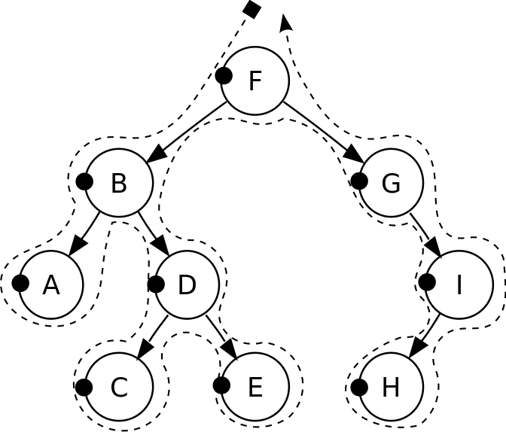
Pre-order traversal
Notes:
F, B, A, D, C, E, G, I, H
Seen before when we talked about marshalling huffman tries to the compressed file
Good for evaluating Polish notation

Slide 6
Traversals of a Binary Tree
Preorder traversal
Visit root before we visit root’s subtrees
Inorder traversal
Visit root of a binary tree between visiting nodes in root’s subtrees.

Slide 7
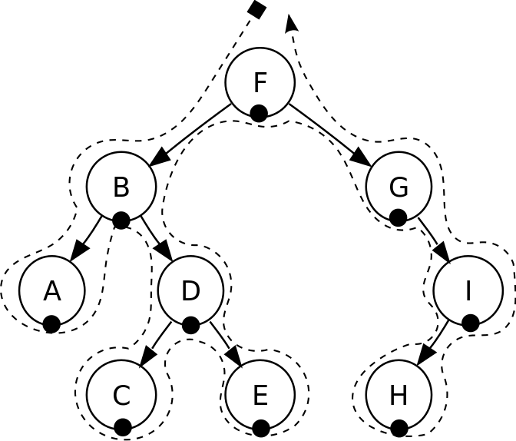
In-order traversal
Notes:
A, B, C, D, E, F, G, H, I
Seen when we wanted to enumerate all values stored in a B-tree (motivating the need for a B+tree)
Good for sorted ordering (if dealing with sorted data structure)

Slide 8
Traversals of a Binary Tree
Preorder traversal
Visit root before we visit root’s subtrees
Inorder traversal
Visit root of a binary tree between visiting nodes in root’s subtrees.
Postorder traversal
Visit root of a binary tree after visiting nodes in root’s subtrees
Level-order traversal
Begin at root and visit nodes one level at a time

Slide 9
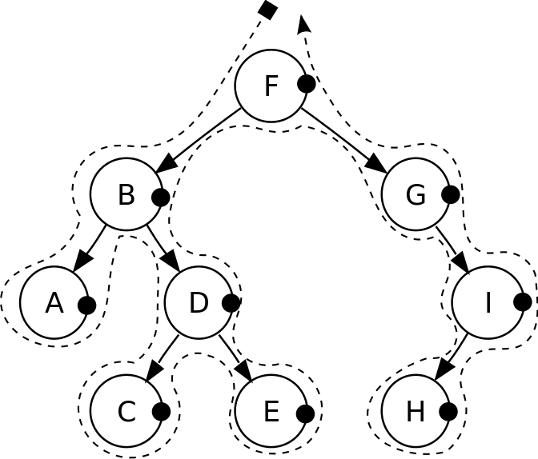
Post-order traversal
Notes:
A, C, E, D, B, H, I, G, F
Good for reverse Polish notation

Slide 10
Traversals of a Binary Tree
Preorder traversal
Visit root before we visit root’s subtrees
Inorder traversal
Visit root of a binary tree between visiting nodes in root’s subtrees.
Postorder traversal
Visit root of a binary tree after visiting nodes in root’s subtrees
Level-order traversal
Begin at root and visit nodes one level at a time

Slide 11
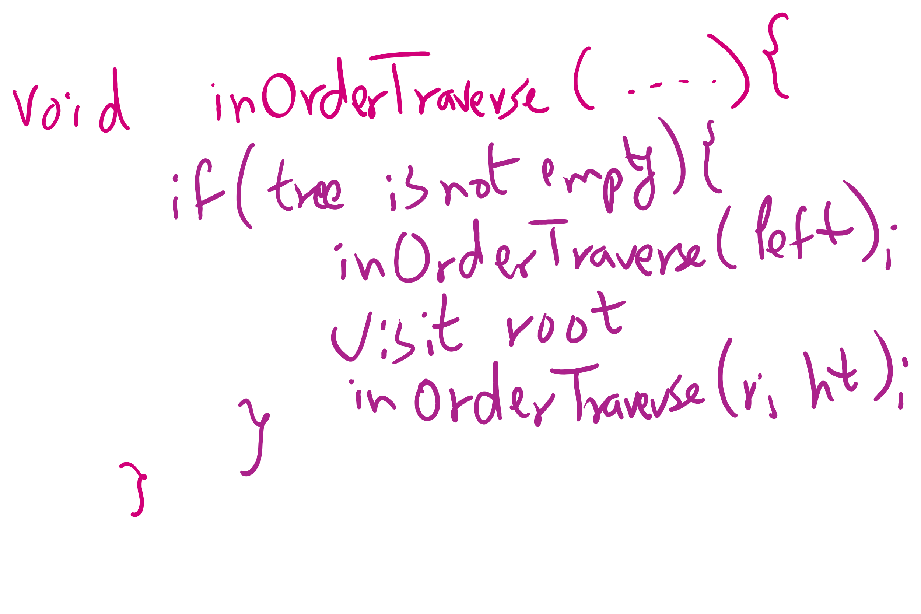
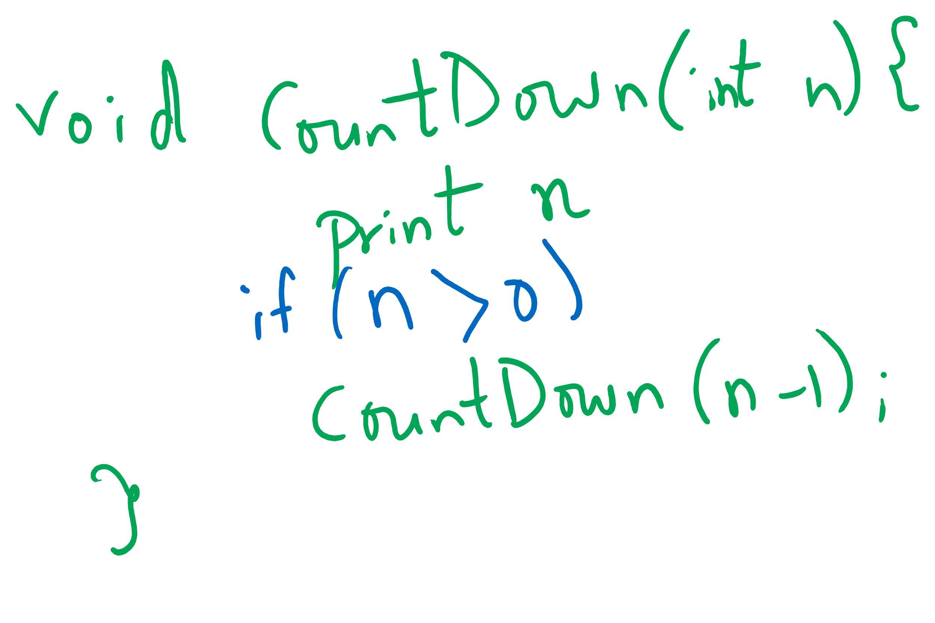
Tail-recursive Examples

Slide 12
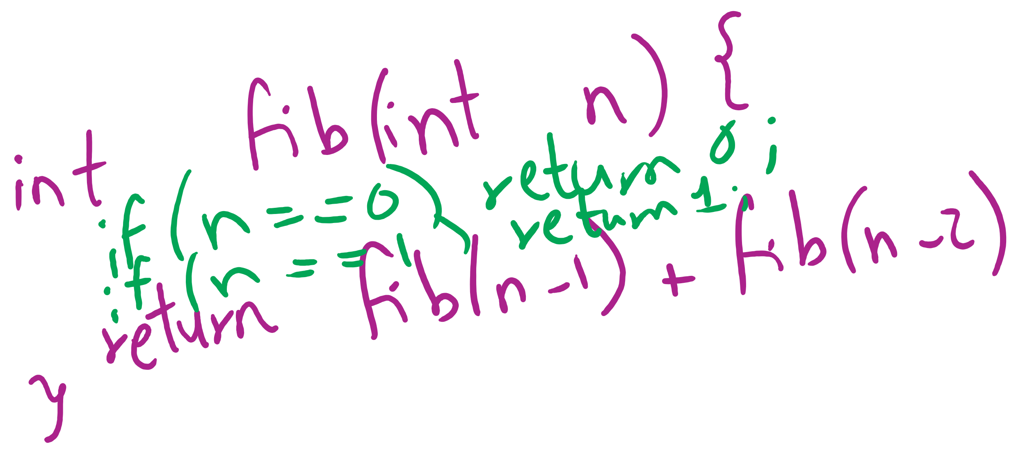
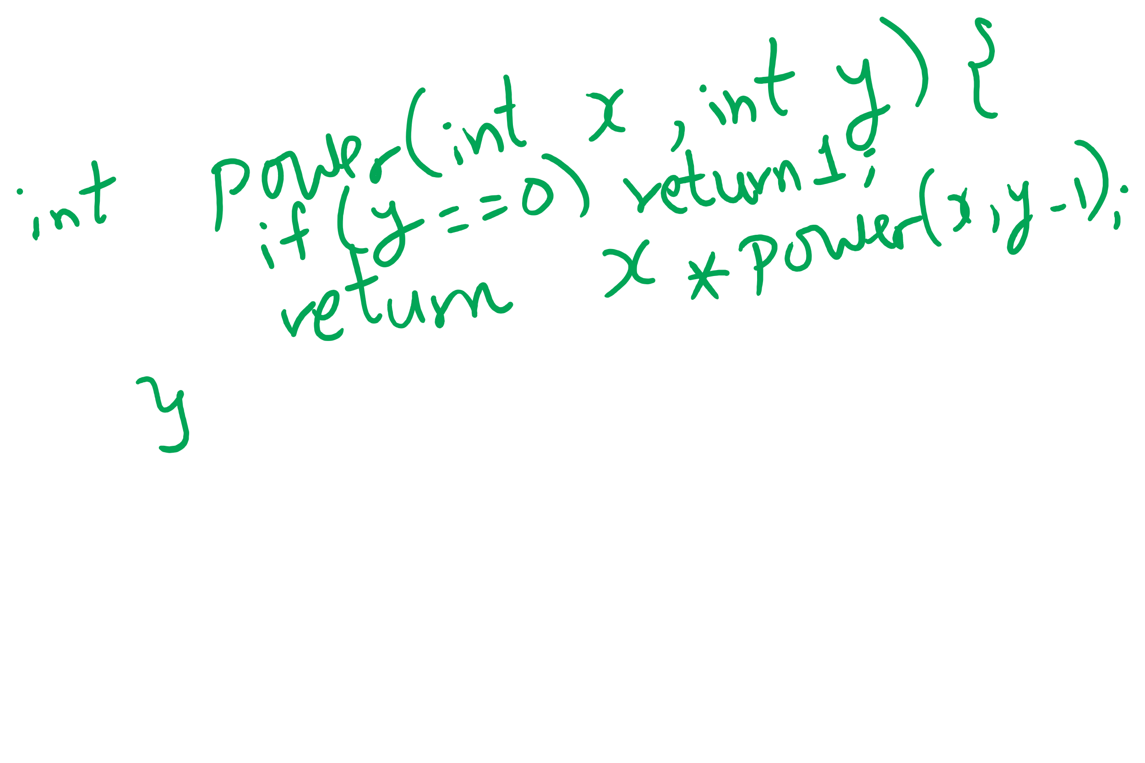
Non-tail recursive Examples

Slide 13
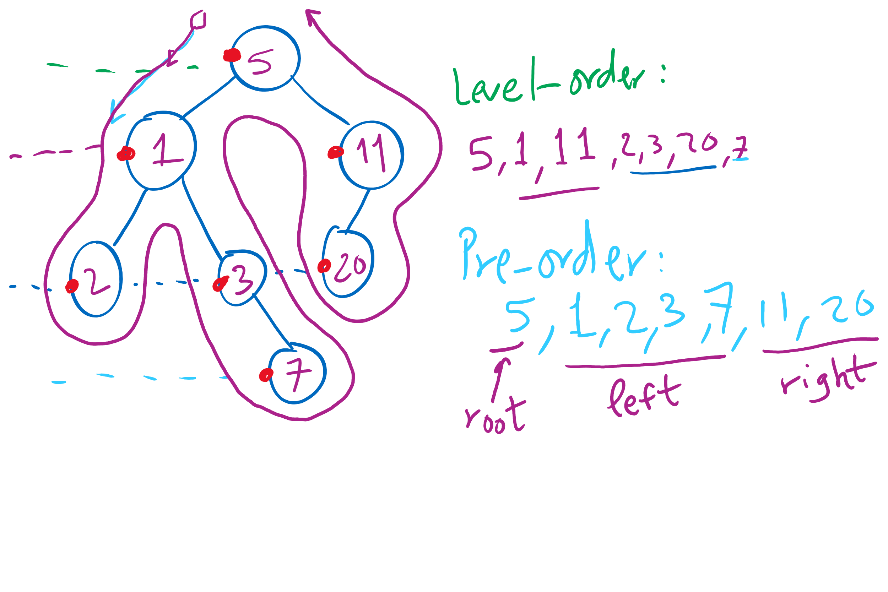
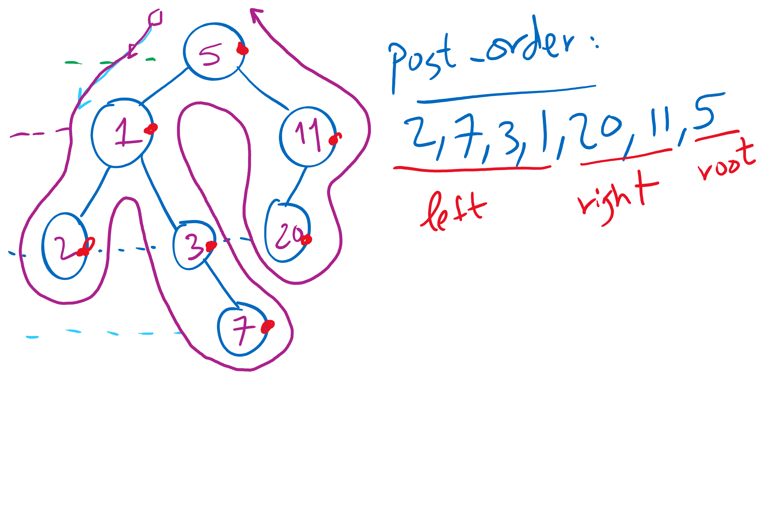
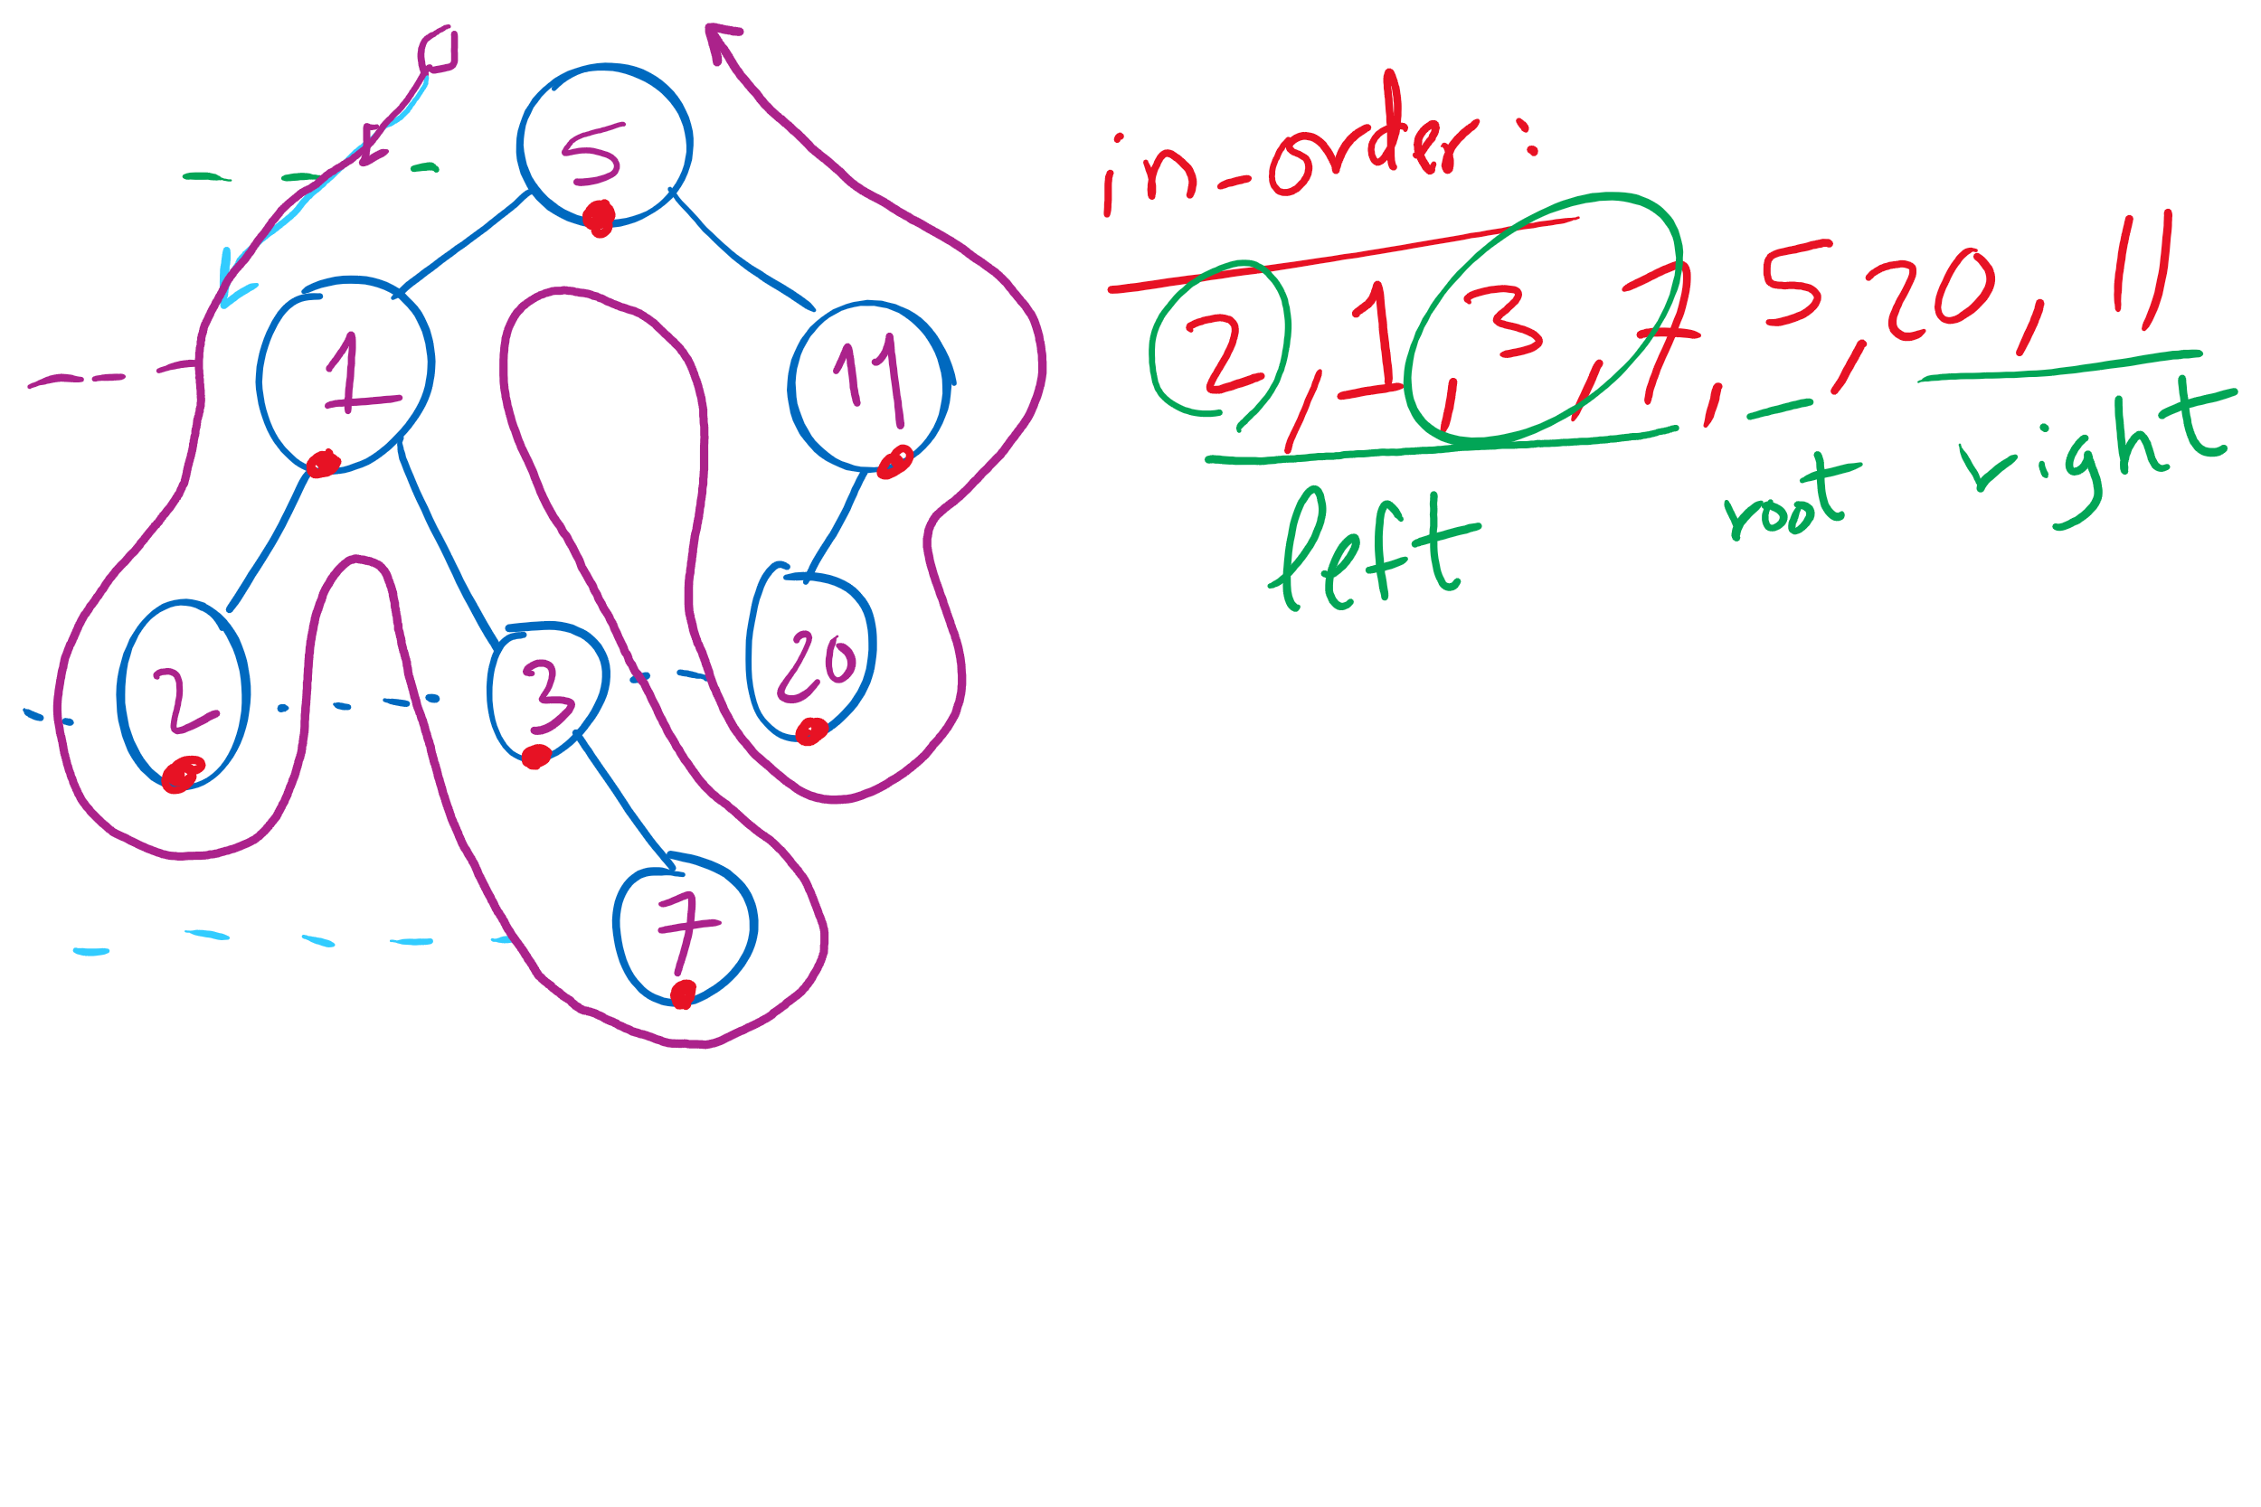
Tree Traversal Example 1

Slide 14
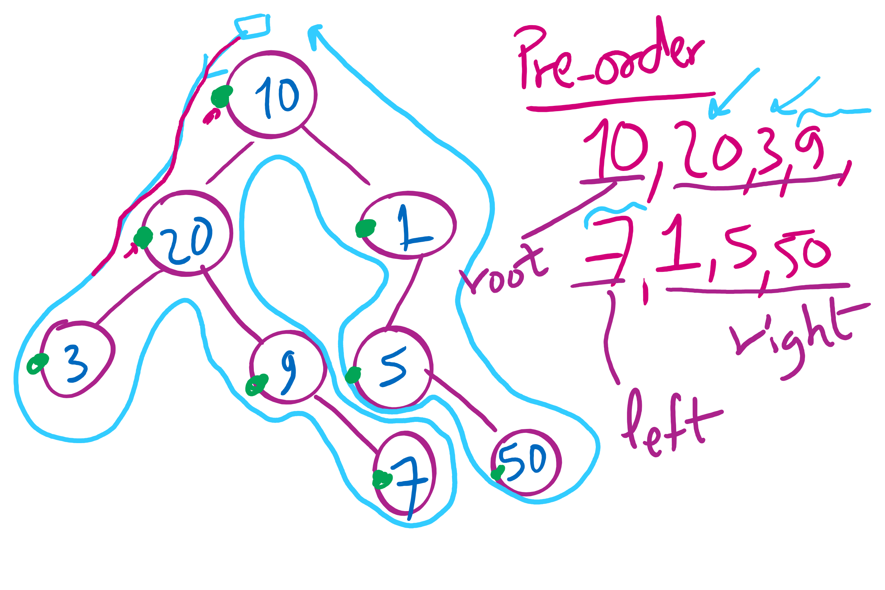
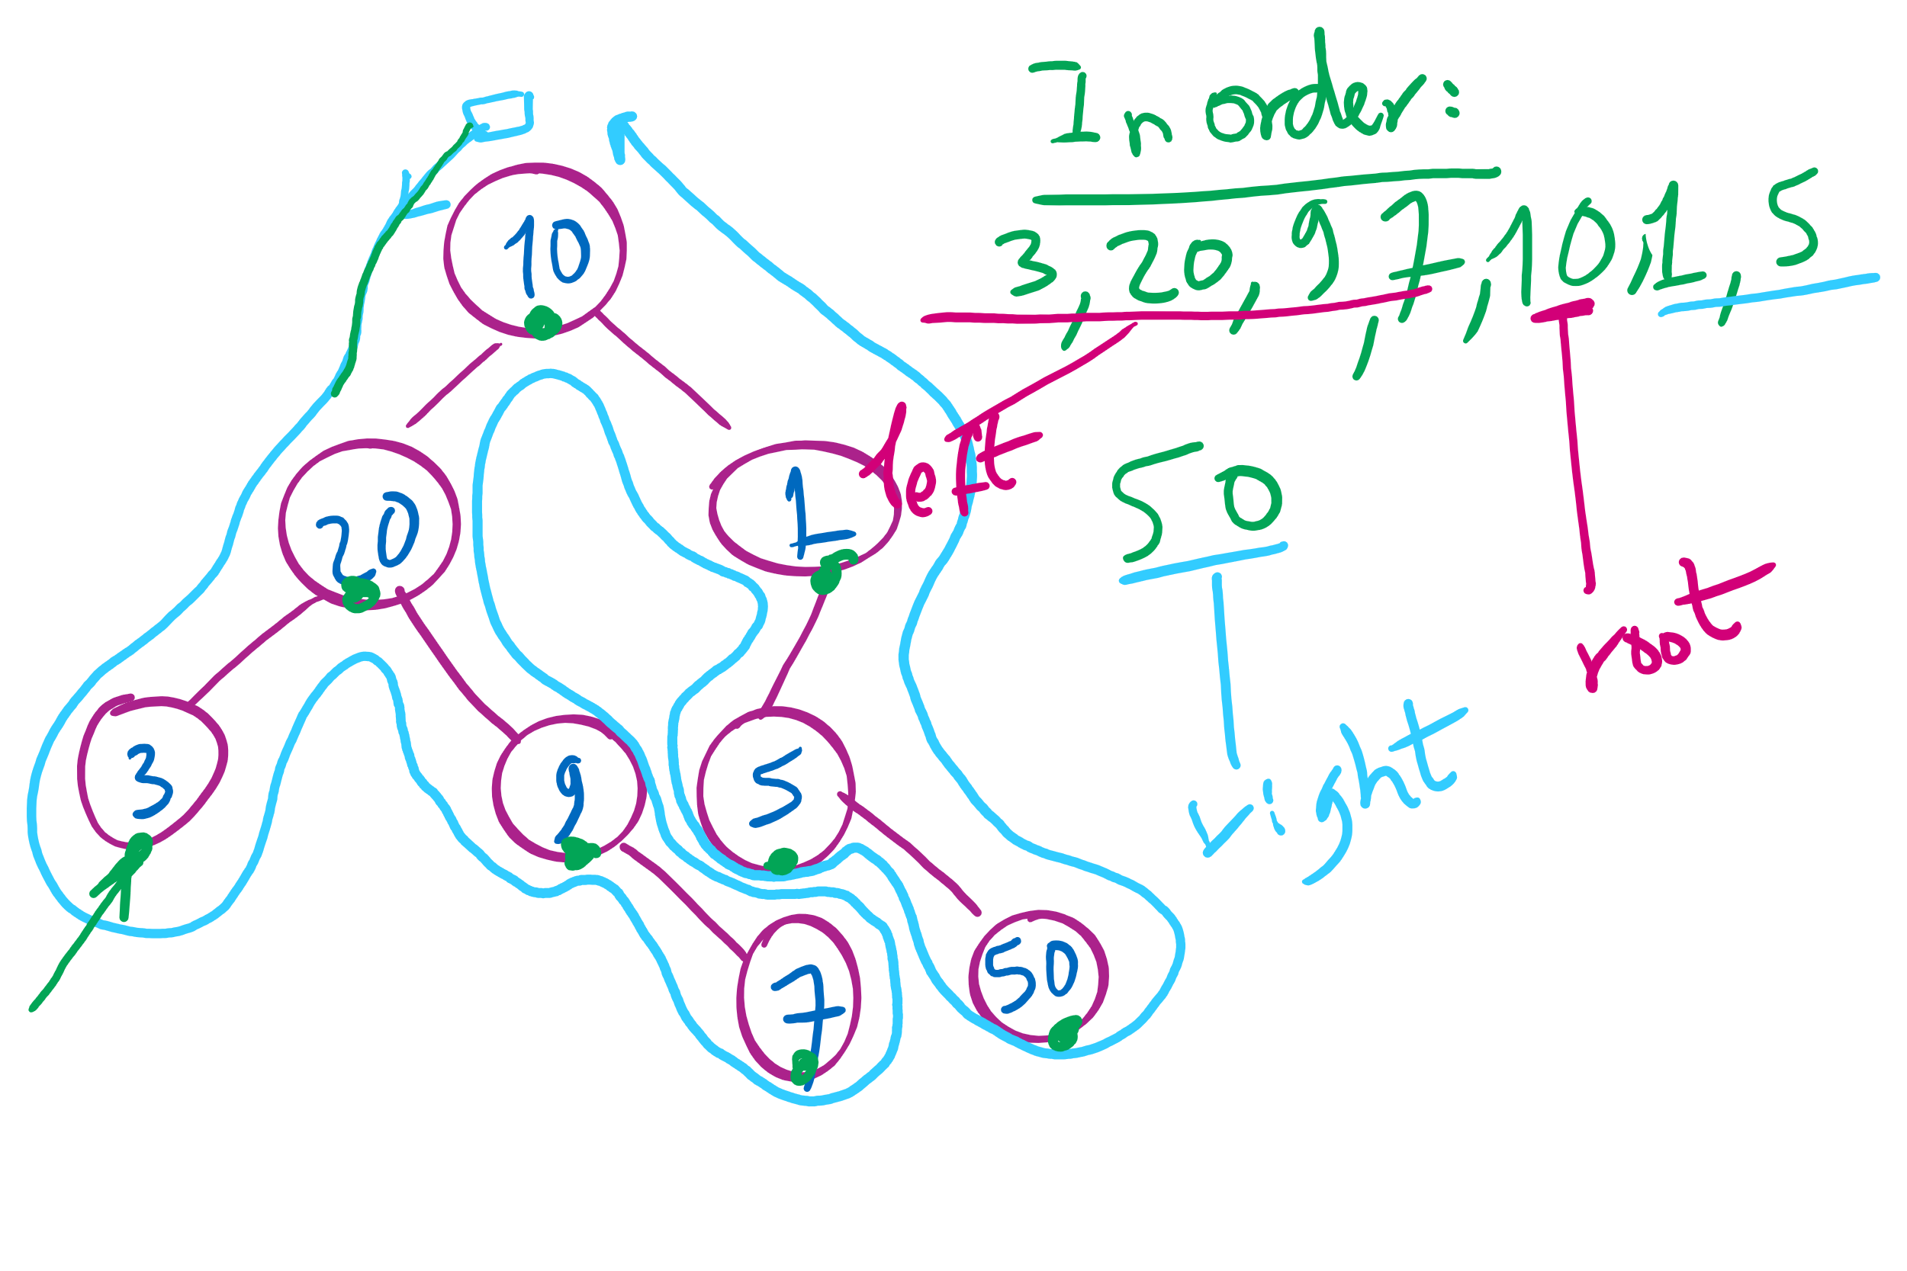
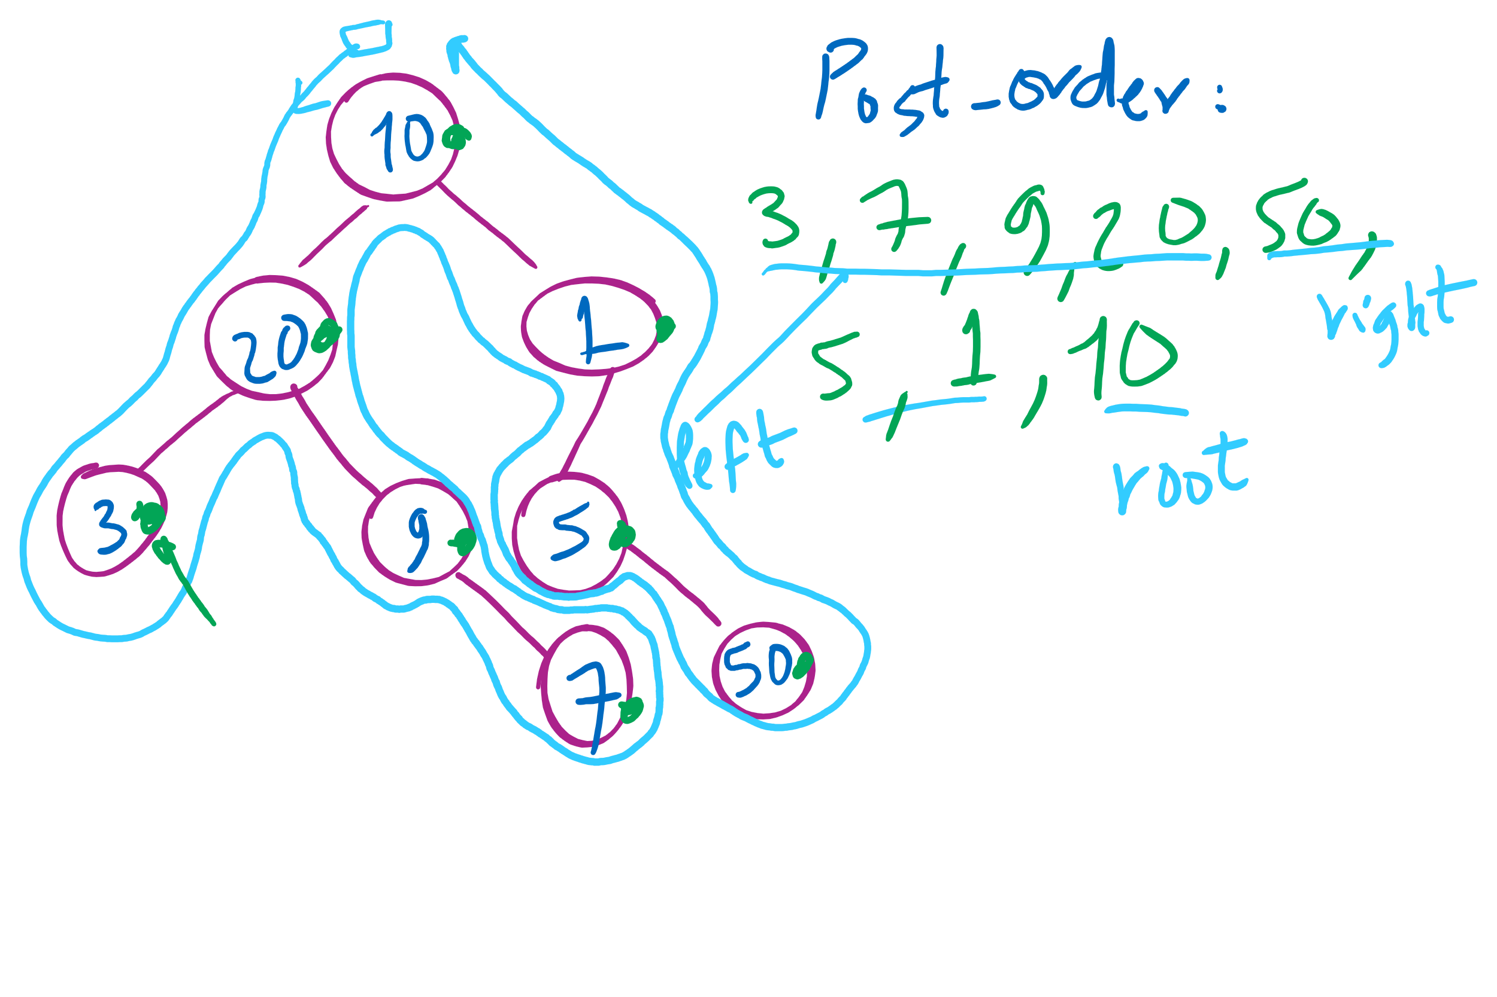
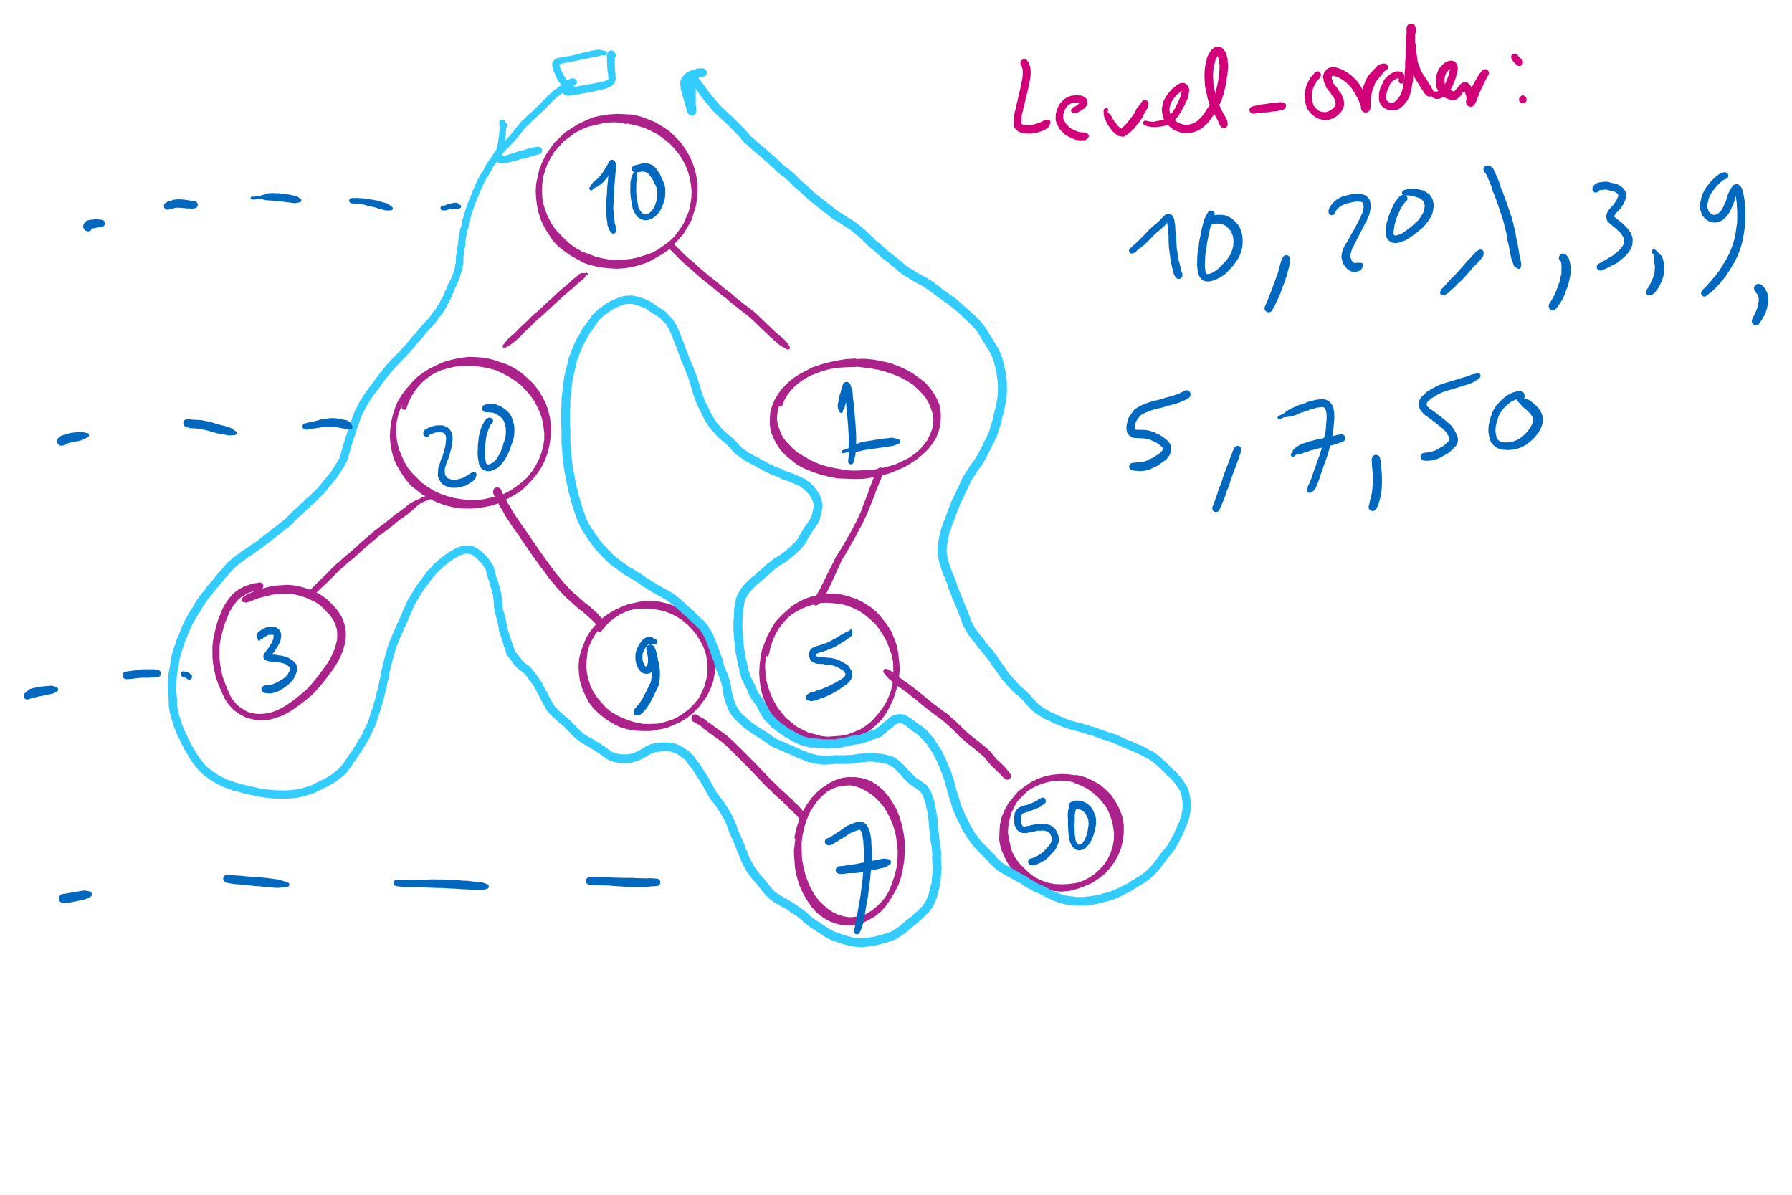
Tree Traversal Example 2

Slide 15
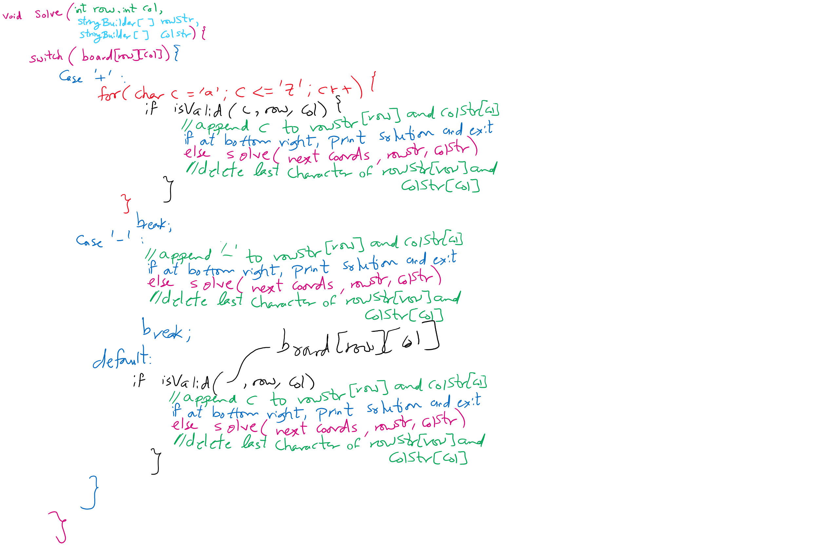
Assignment 1 Hints

Slide 16
Code Walkthrough
Available online at:
https://cs1501-2221.github.io/handouts/CodeHandouts/TreeADT/Slides
The slides are under the CodeHandouts/TreeADT/slides folder in the handout repository
https://github.com/cs1501-2221/handouts

Slide 17
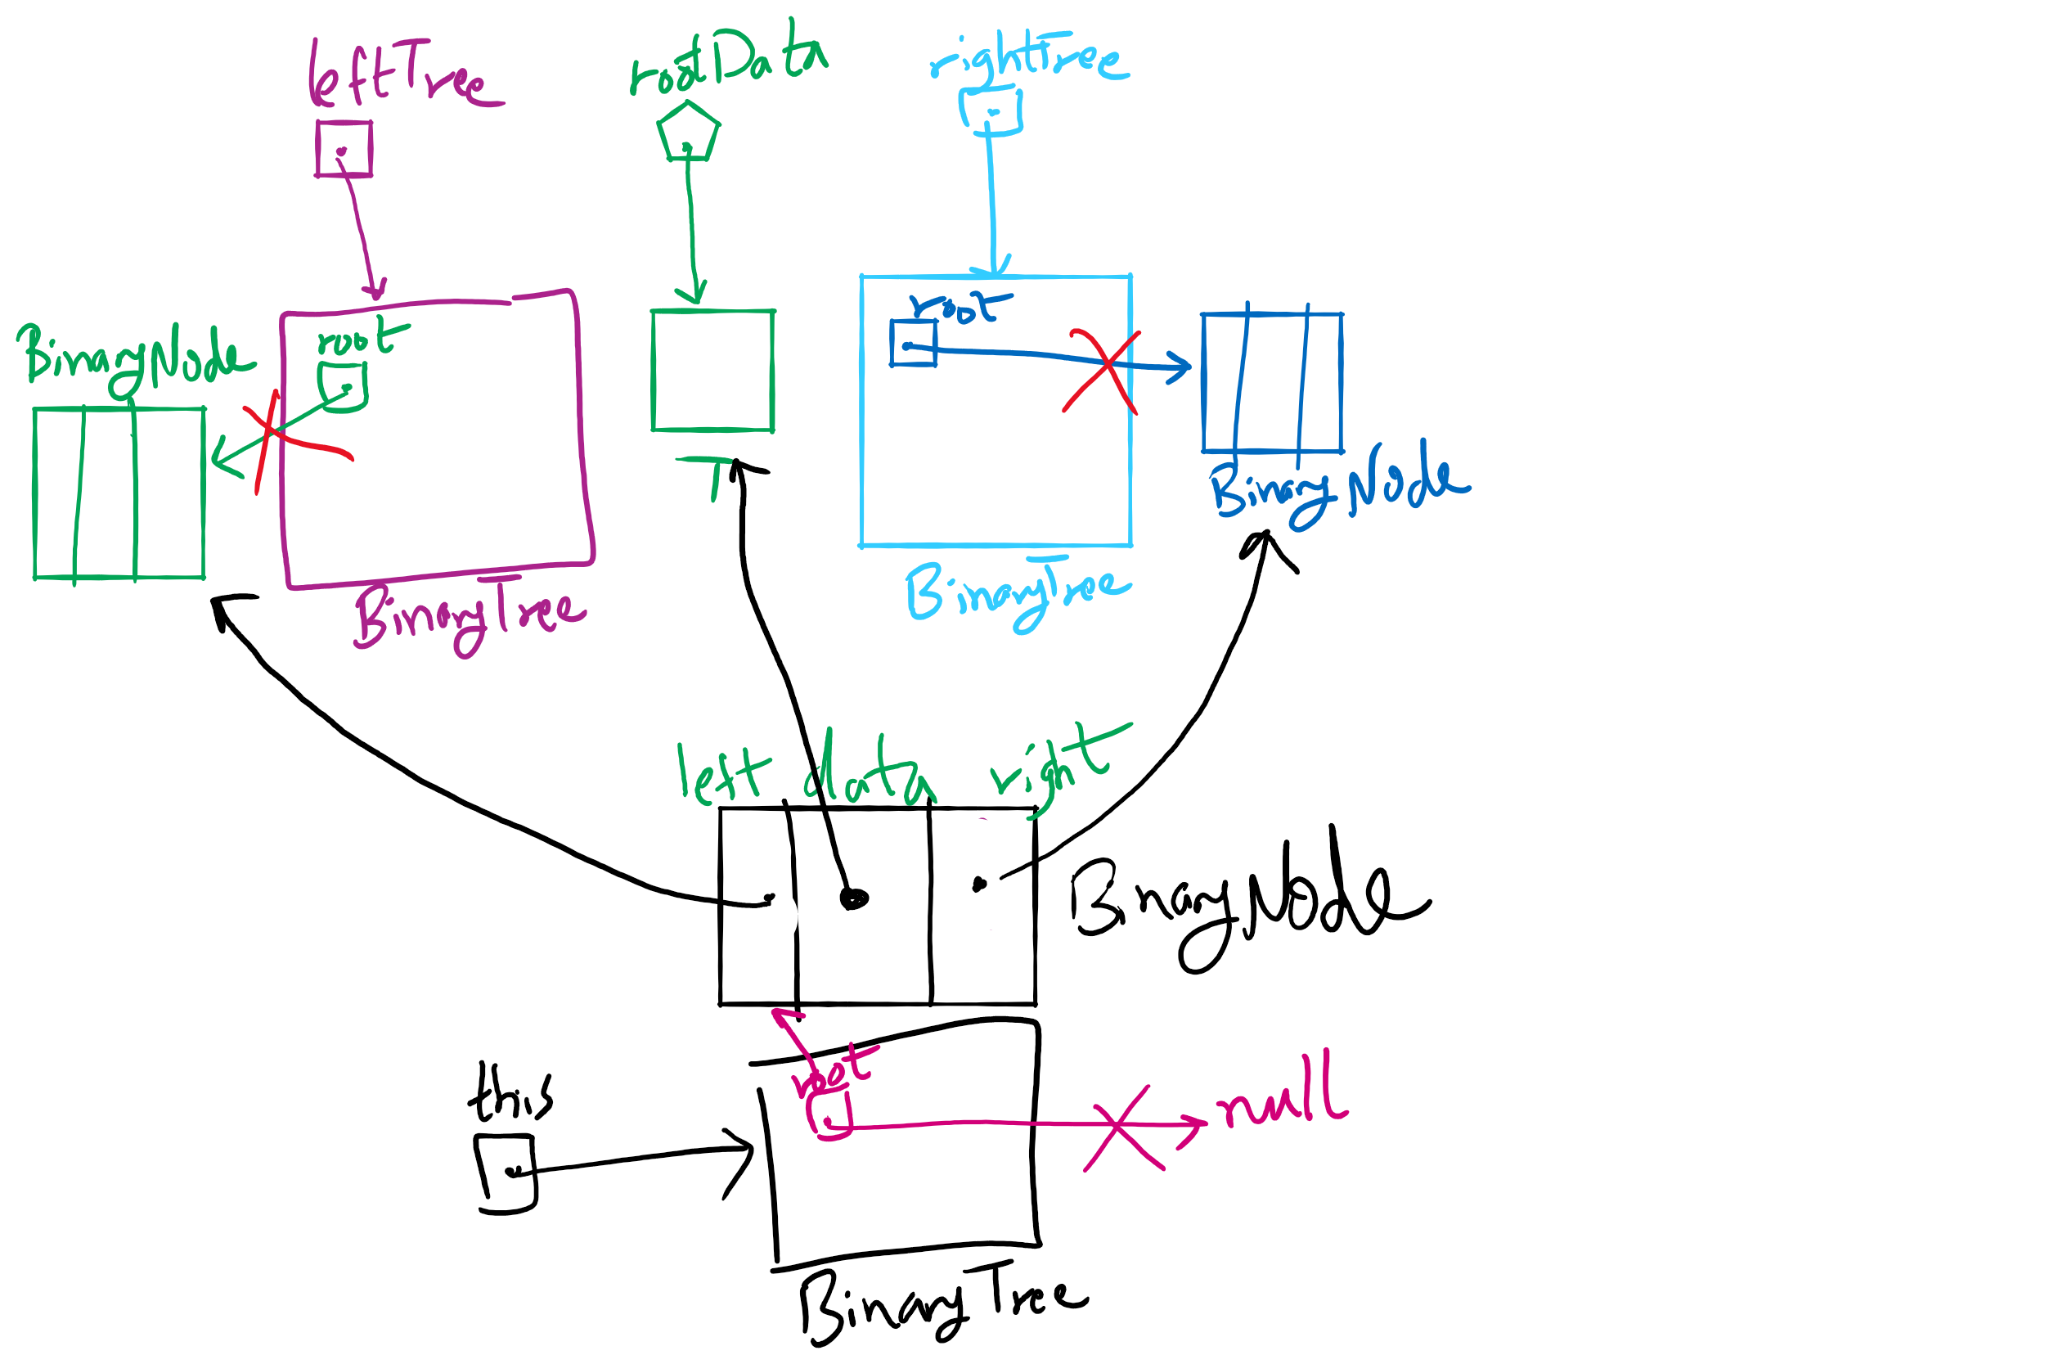
privateBuildTree Method

Slide 18
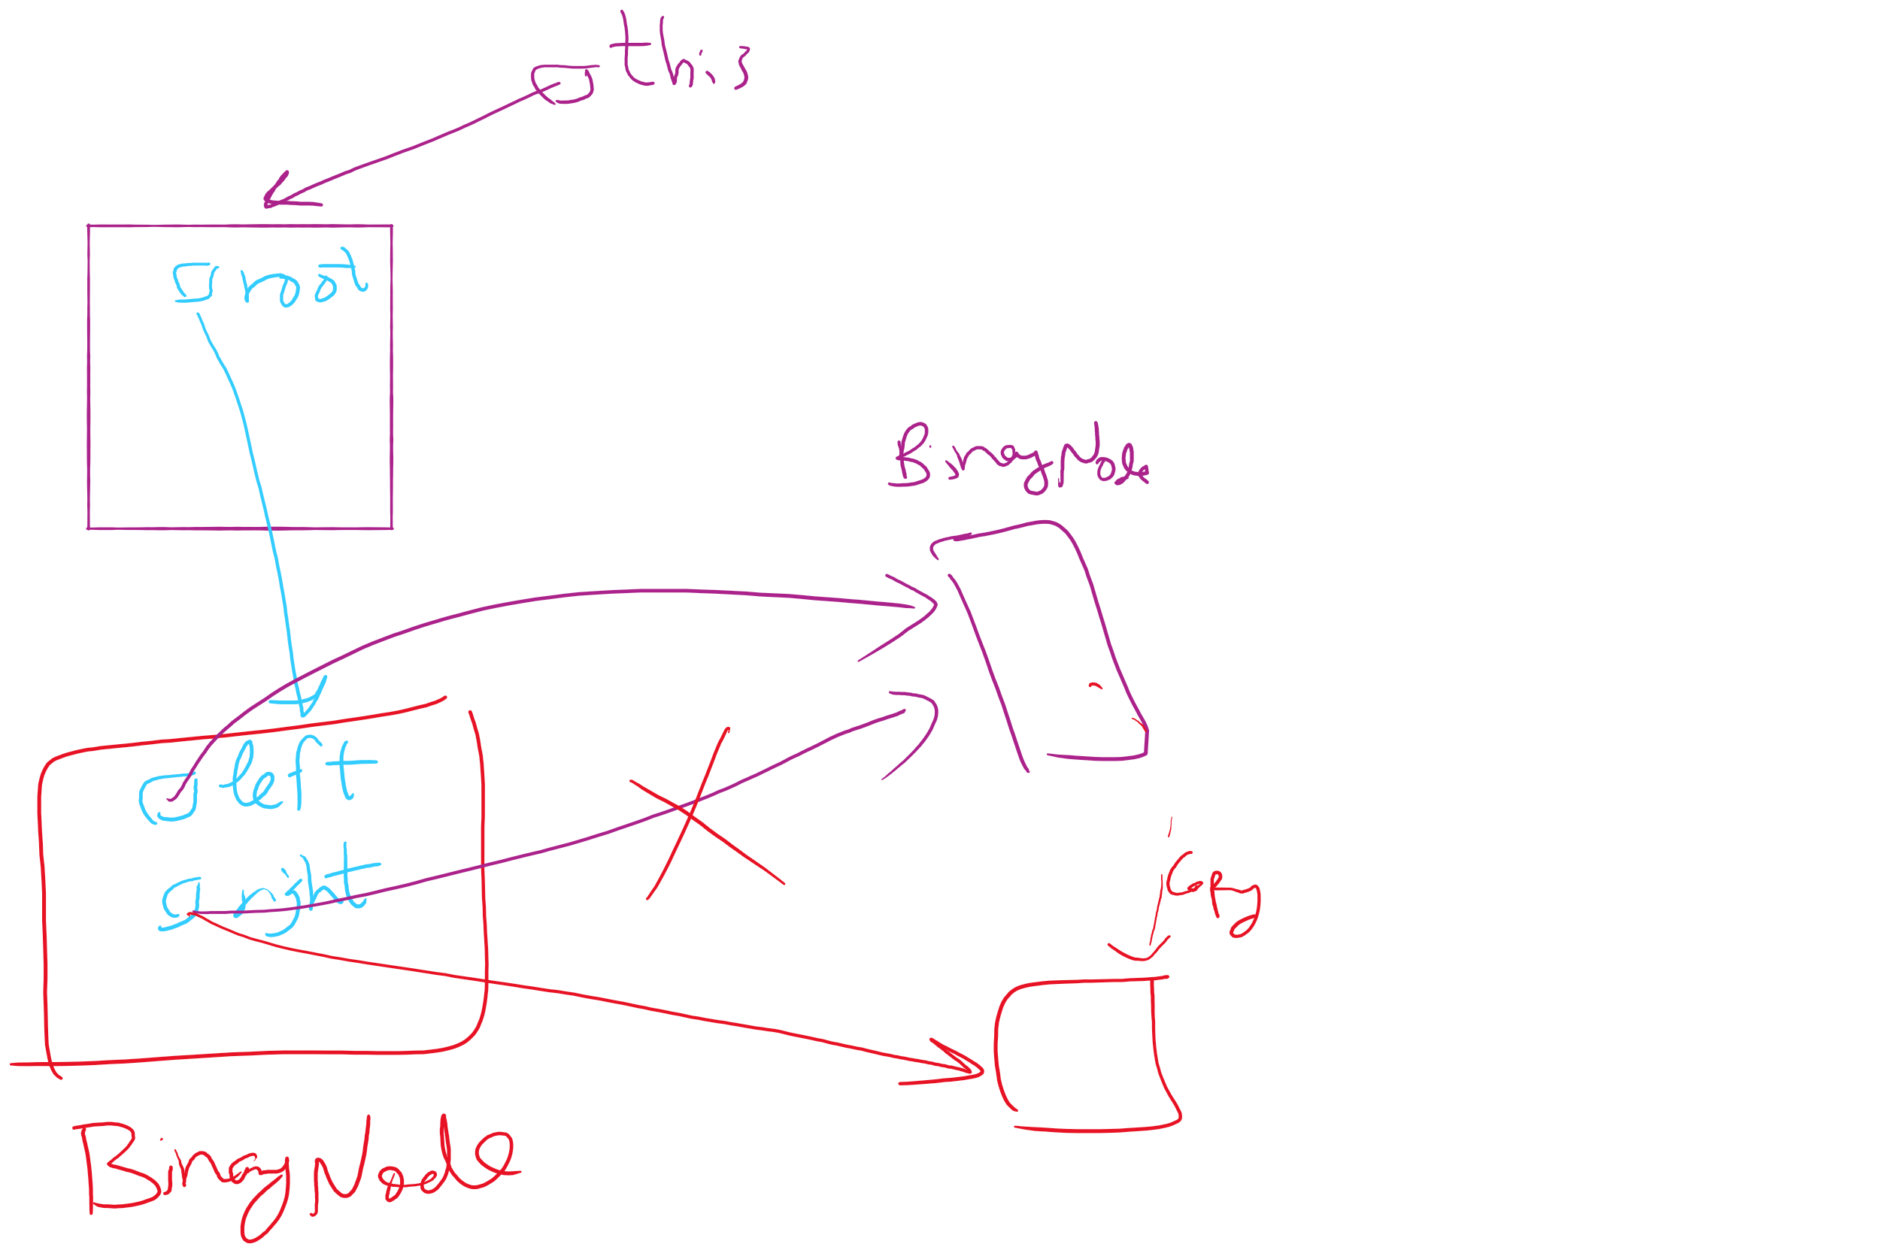
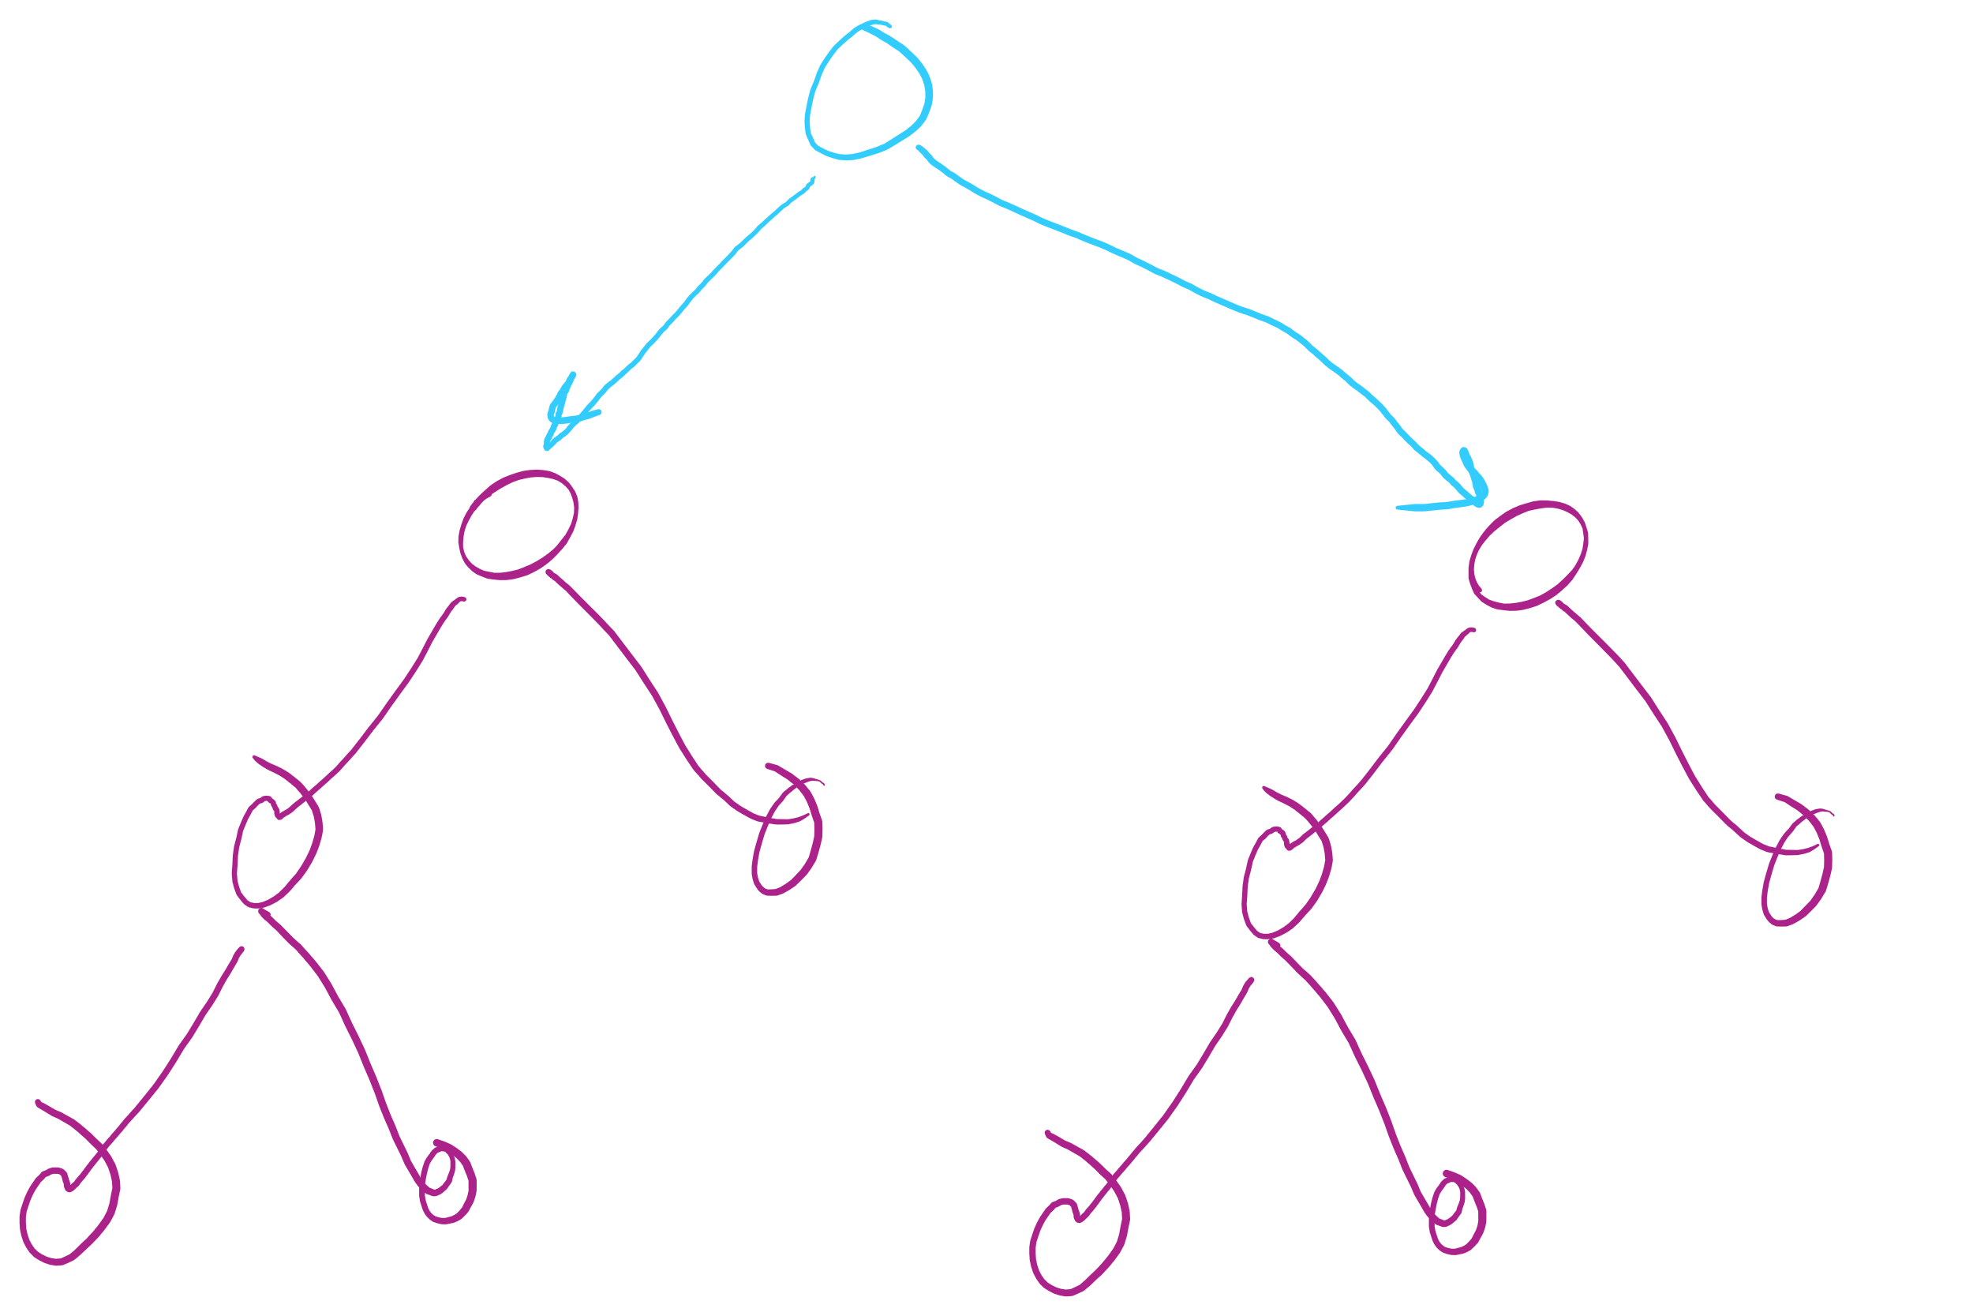
privateBuildTree Special Case #1
leftTree == rightTree

Slide 19
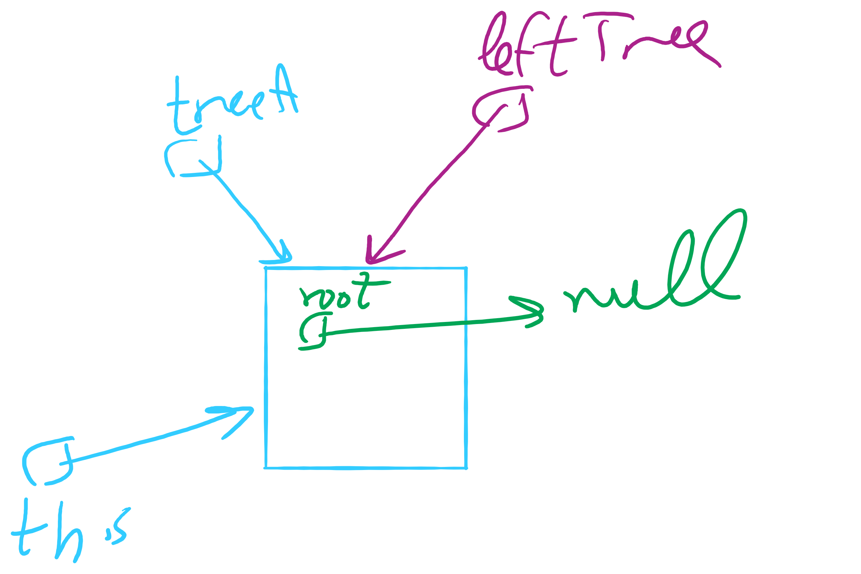
privateBuildTree Special Case #2
leftTree (or rightTree or both) == this

Slide 20
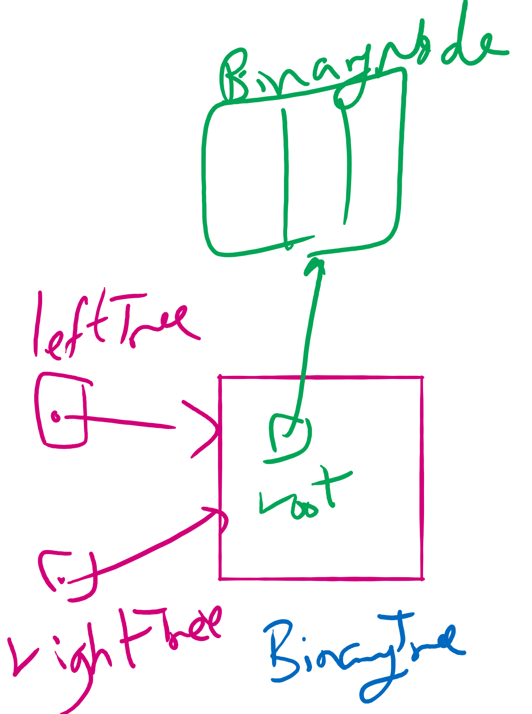
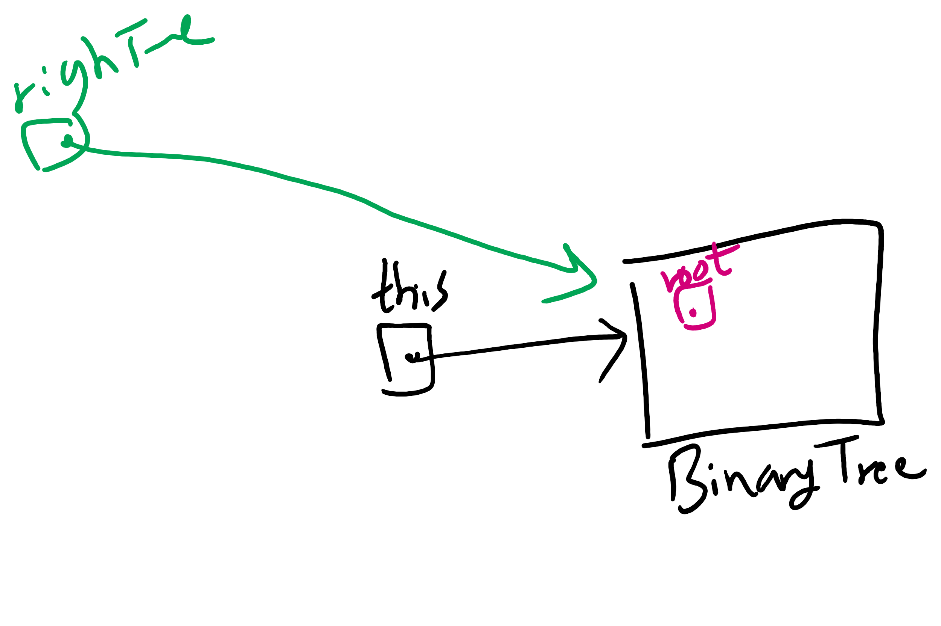
privateBuildTree Corner Cases

Slide 21
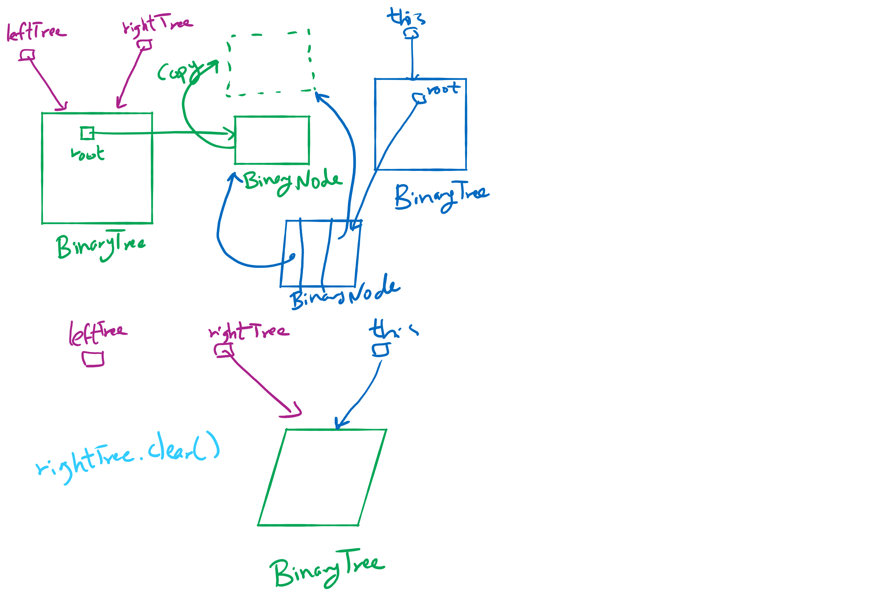
privateBuildTree Special Cases

